Slide 2
Worldskills event Birmingham
This is an exciting opportunity to look at the job opportunities available in a major job convention in Birmingham. The cost is £12.00 to help support the cost of travel by coach. This is a unique opportunity and not one we would want them to miss out on!!

Slide 3
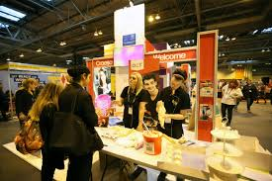

Slide 4
